Slide 1
OCR
Optical character recognition

Slide 2
INTRODUCTION
Nowadays, a lot of paper documents are transformed to electronic form, which makes information processing easier , like searching, analysis and conversion.
Also working with digitized document is cheaper than processing traditional documents, because there is no space required for document storage.
Document digitization include three main steps: scanning, indexation and presentation.
Researchers proved that the recognition of both barcodes and printed text through Optical Character Recognition is more reliable and significantly accelerates data processing.

Slide 3
WHAT IS OCR?
OCR is the process of electrical or mechanical conversion of images of typed, handwritten or printed text into machine encoded text.
OCR is a field of research in pattern recognition, artificial intelligence and computer vision.
It can be defined as the electronic translation of handwritten, typewritten or printed text into machine translated images.
It is a common method of digitizing so that they can be electronically edited and searched more compactly.

Slide 4
ATTRIBUTES OF OCR
TEXT DENSITY
Text in an image of written or printed document are dense. But not an image of street with a sign board.
STRUCTURE
Texts on pages are o strict rows. While text in wild may be sprinkled
FONTS
Printed fonts are easier since more structured and less noisy than handwritten characters.
CHARACTER TYPE
Text may come in different language which may be very different from each other. Additionally, structure of text may be different from numbers, such as house numbers etc.

Slide 5
ARTIFACTS
Out side pictures are more noisy than scanner.
LOCATIONS
Some tasks include cropped/centered text, while in others, text may be located in random locations in the image.

Slide 6
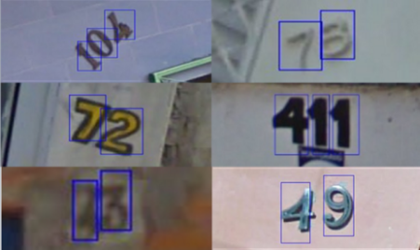
DATASETS/TASKS
SVHN (STREET VIEW HOUSE NUMBERS DATASET)
House numbers are extracted from street view.
Task is of intermediate difficulty.
There may be different shape and writing styles.
Text is generally located in middle of image but wont have high resolution.
A bit particular arrangement.

Slide 7
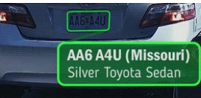
LICENSE PLATE
OCR is useful in license plate recognition.
It requires to detect the license plate, and then recognizing it’s characters.
Since the plate’s shape is relatively constant, some approach use simple reshaping method before actually recognizing the digits.

Slide 8
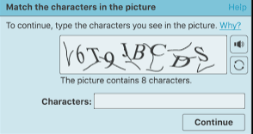
CAPTCHA
Vision tasks aka. Captcha, is a common practice to tell humans apart from robots.
Random and distorted text makes it hard to read .
Most of captchas are not hard unless if not tried all together.
PDF OCR
Printed/pdf OCR is the most common and easy task since they are more structured texts..
Most of OCR tools gives very good results in this task.

Slide 9
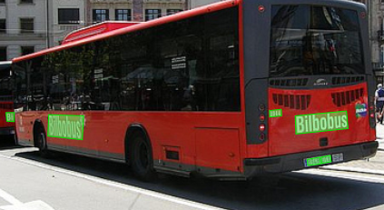
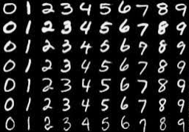
OCR IN WILD
Uses street views to extract texts.
Most challenging since it is introduce to a lot of noises, lighting and artifacts.
MNIST TEXT
The MNIST database is a large database of handwritten digits that is commonly used for training various image processing systems.
In some approaches every letter will be detected separately, and then MNIST like (classification) models become relevant.

Slide 10
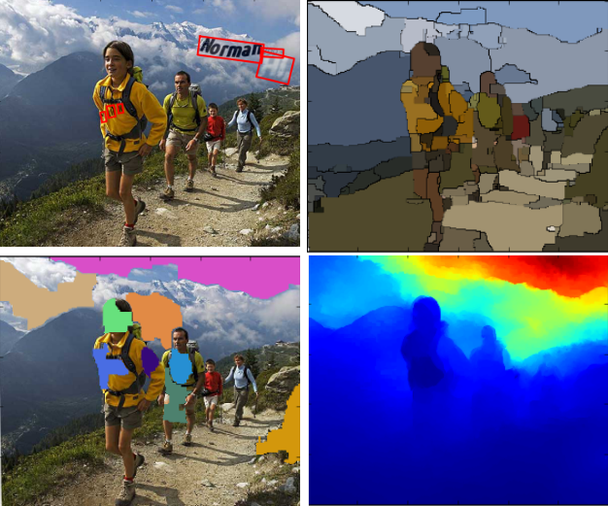
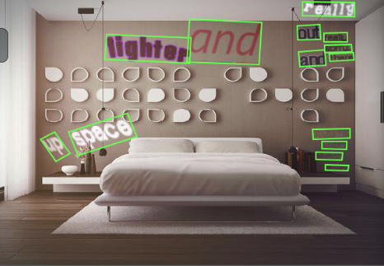
SYNTH TEXT
Synth Text is synthetically generated dataset, in which texts are placed in natural scene images with suitable layout.
Random text in images looks natural in images since they are flat
To make the text look realistic and useful, the Synth Text library takes with every image two masks, one of depth and another of segmentation.

Slide 11
STRATEGIES
The text recognition is mostly a two-step task.
Detect the text(s) appearances in the image, may it be dense (as in printed document) or sparse (As text in the wild).
After detecting the line/word level we can choose once again from a large set of solutions by –
Classic computer vision techniques.
Specialized deep learning.
Standard deep learning approach (Detection).

Slide 12
CLASSIC COMPUTER VISION TECHNIQUES
The classic-CV approach generally claims:
Apply filters to make the characters stand out from the background.
Apply contour detection to recognize the characters one by one.
Apply image classification to identify the characters. Easy if part two is done well with pattern matching and machine learning eg. MNIST.
Contour detection is challenging. It requires a lot of manual fine tuning, therefore becomes infeasible in most of the problem.

Slide 13
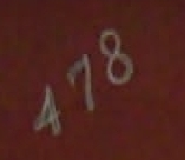
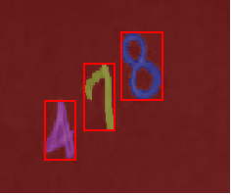
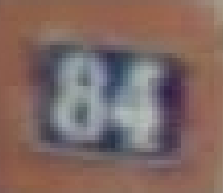
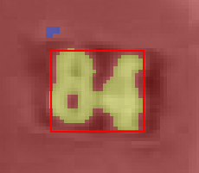
Task get hard as the characters gets closer. It is better to stick to the parameters instead of causing more errors in an attempt to reduce errors and keep your task straight forward.

Slide 14
SPECIALIZED DEEP LEARNING APPROACHES
Generally most successful deep learning approach.
Every article is opened with the words “task X (text recognition) gains attention lately”.
Results are also depicted thoroughly, however due to many differences in design (including minor differences in data sets)actual comparison is quite impossible. The only way to actually know the performance of these methods on your task, is to get their code.

Slide 15
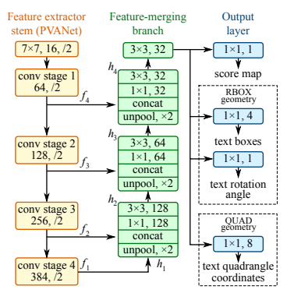
EAST
EAST ( Efficient accurate scene text detector) is a simple yet powerful approach for text detection. Using a specialized network.
It is a robust method limited only to text detection (not actual recognition).
It was also added to opencv library from version 4 (U-Net) making it easy and able to detect features varying in size.
The underlying feed forward “STEM” (as coined in the article, see figure below) of this network may very — PVANet is used in the paper, however opencv implementation uses Resnet. Obviously, it can be also pre-trained (with imagenet e.g) . As in U-Net, features are extracted from different levels in the network.
The network allows two outputs rotated bounding boxes: either a standard bounding box with a rotation angle (2x2+1 parameters) or “quadrangle” which is merely a rotated bounding box with coordinates of all vertices reducing the effort to recognize.

Slide 16
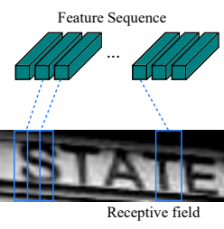
CRNN
Convolutional-recurrent neural network suggest a hybrid of end to end architecture, that is intended to capture words, in a three step approach.
The first level is a standard fully convolutional network. The last layer of the net is defined as feature layer, and divided into “feature columns”.

Slide 17
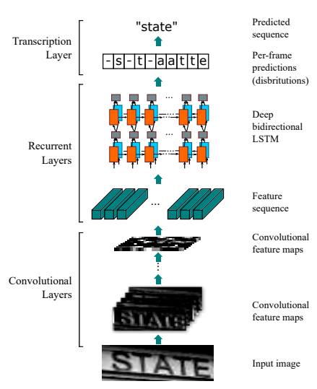
The feature columns are fed into a deep-bidirectional LSTM which outputs a sequence, and is intended for finding relations between the characters.
Finally, the third part is a transcription layer. Its goal is to take the messy character sequence, in which some characters are redundant and others are blank, and use probabilistic method to unify and make sense out of it.
This method is called CTC loss. This layer can be used with/without predefined lexicon, which may facilitate predictions of words.
This paper reaches high (>95%) rates of accuracy with fixed text lexicon, and varying rates of success without it.

Slide 18
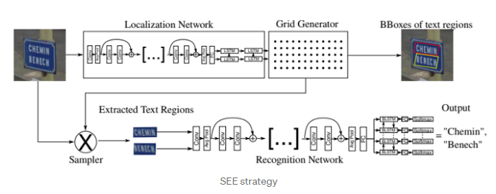
STN-NET/SEE
SEE — Semi-Supervised End-to-End Scene Text
Recognition, is a work by Christian Bartzi, apply a truly end to end strategy to detect and recognize text. They train the network with only text annotation. This allows them use more data, but makes it quite challenging, and they try different tricks to make it work, e.g not training on images with more than two lines of text.

Slide 19
The name STN-OCR hints on the strategy, of using spatial transformer.
They train two concatenated networks in which the first network, the transformer, learns a transformation on the image to output an easier sub-image to interpret. Then, another feed forward network with LSTM on top to recognize the text.
The researches emphasize here the importance of using resnet since it provides “strong” propagation to the early layers. However this practice quite accepted nowadays.

Slide 20
STANDARD DEEP LEARNING APPROACH
After detecting words we can apply standard deep learning detection approaches, such as SSD, YOLO and Mask RCNN.
SSD and other detection models are challenged when it comes to dense data.
Deep learning models find it much more difficult to recognize digits and letters than to recognize much more challenging and elaborate objects such as dogs, cats or humans.
They tend not to reach the desired accuracy, and therefore, specialized approaches thrive.

Slide 21
Try some modelling ourselves. We will try the tackle SVHN task. The SVHN data contains three different data-sets: train, test and extra.
To prepare for the task, do the following:
You’ll need a basic GPU machine with Tensorflow≥1.4 and Keras≥2
Clone the SSD_Keras project from here.
Download the pre-trained SSD300 model on coco data-set from here.
Clone this project's repo from here..
Download the extra.tar.gz file, which contains the extra images of SVHN data-set.
Update all relevant paths in json_config.json in this project repo

Slide 22
STEP 1:PARSE THE DATA
There is no golden format for data representation in detection tasks. Some well known formats are: coco, via, pascal, xml. And there are more. For instance, the SVHN dataset is annotated with the obscure .mat format.
We should have a pascal.csv file that is much more standard and will allow us to progress. If the conversion is to slow,you should take note that we don’t need at all the data samples.

Slide 23
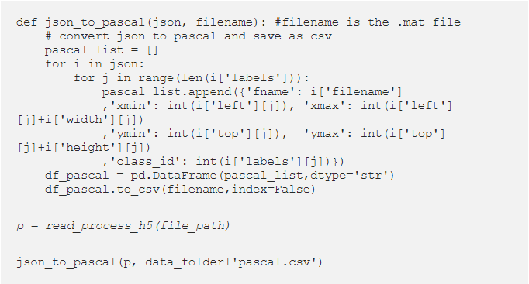

Slide 24
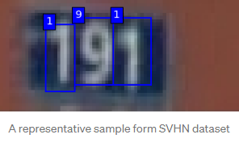
STEP 2: LOOK AT THE DATA
Before starting the modeling process, you should better do some exploration of the data.
Some of the code is taken from the SSD_Keras repo, which is also used extensively.

Slide 25
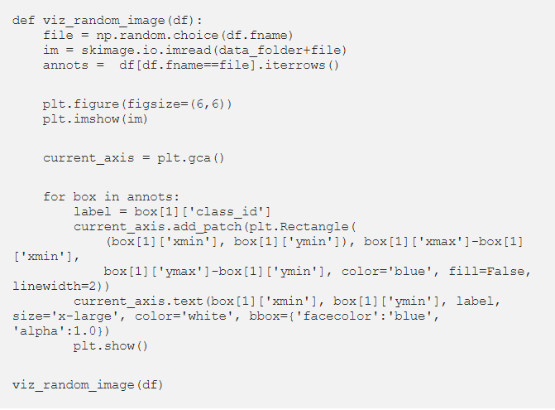

Slide 26
STEP 3: CHOOSING STRATEGY
we have many possible approaches for this problem.
In this tutorial I’ll take standard deep learning detection approach, and will use the SSD detection model. We will use the SSD keras implementation from here.
Other good choices will be the YOLO model, and the Mask RCNN.

Slide 27
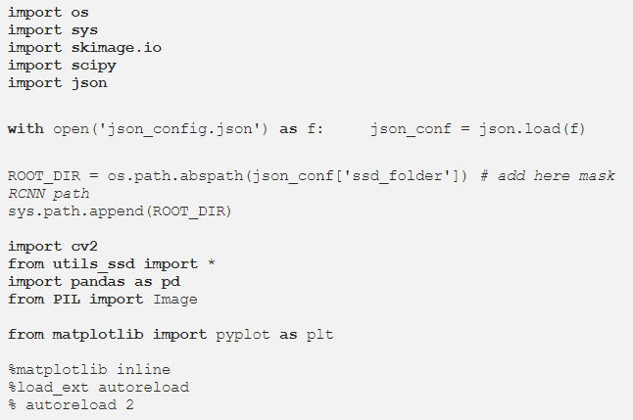
STEP 4: LOAD AND TRAIN THE SSD MODEL
You’ll need to verify you have the SSD_keras repo, and fill in the paths in the json_config.json file
Start with the imports:

Slide 28
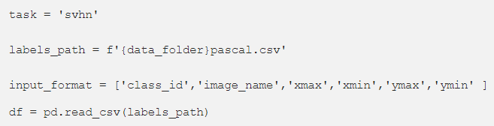
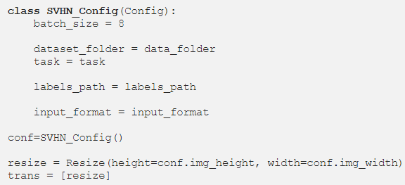
and some more definitions:
Model configurations:

Slide 29
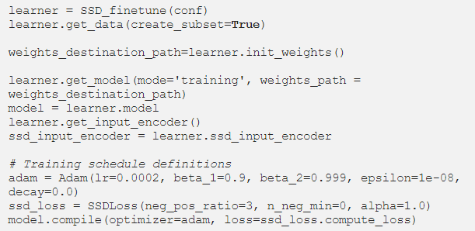
DEFINE THE MODEL, LOAD WEIGHTS
We won’t start training from scratch, but we’ll load pre-trained weights. In this case, we’ll load the weight of SSD model, trained on COCO data-set, which has 80 classes. Clearly our task has only 10 classes, therefore we will reconstruct the top layer to have the right number of outputs, after our loading the weights. We do it in the init_weights function.

Slide 30
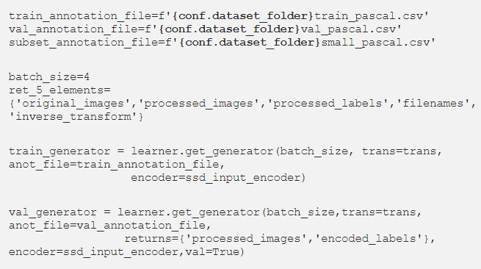
DEFINE DATA LOADERS

Slide 31


STEP5. TRAINING THE MODEL
Now that the model is ready, we’ll set some last training related definitions, and start training
The SSD_Keras repo handles saving the model after almost each epoch , so you can load later the models simply by changing the weights_destination_path line to equal the path.

Slide 32
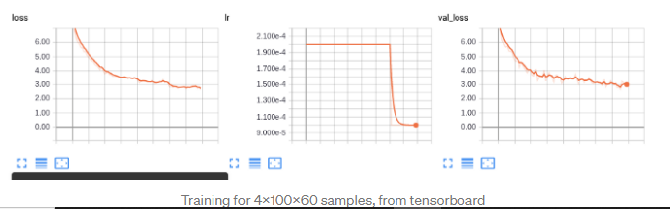
If you followed my instructions, you should be able to train the model. The ssd_keras provides some more features, e.g data augmentations, different loaders, and evaluator. I’ve reached >80 mAP after short training.
How high did you achieve?

Slide 33
SUMMARY
We discussed different challenges and approaches in the OCR field. As many problems in deep learning/computer vision, it has much more to it than seems at first. We have seen many sub tasks of it, and some different approaches to solve it, neither currently serves as a silver bullet. From the other hand, we’ve seen it is not very hard to reach preliminary results, without too much of hassle.

Slide 34
THANK YOU

